Slide 1
Flux Balance Analysis
Adrian Verster (averster@uw.edu)
May 4th, 2017

Slide 2
Some intuition
Strain1
Abundance: 0.10
Genotype: ACGCA | AAC
Strain1
Abundance: 0.10
Genotype: GTCAT| AAC
ACGCA
GTCAT
0.5
0.5
0.4
Strain2
Abundance: 0.40
Genotype: ACGCA | TCT
Strain2
Abundance: 0.40
Genotype: GTCAT| TCT
TCT
AAC
0.1
0.9
0.0
Strain3
Abundance: 0.50
Genotype: GTCAT| TCT
Strain3
Abundance: 0.50
Genotype: ACGCA| TCT

Slide 3
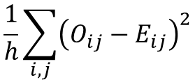
Which is a better fit?
They choosing the best set of strains to minimize the error function
Model 1
Model 2
Strain1
Abundance: 0.10
Genotype: ACGCA | AAC
Strain1
Abundance: 0.10
Genotype: GTCAT| AAC
$$\frac{1}{h}\sum_{i,j}{{\left(O_{ij}−E_{ij}\right)}^{2}}$$
Strain2
Abundance: 0.40
Genotype: ACGCA | TCT
Strain2
Abundance: 0.40
Genotype: GTCAT| TCT
i – position
j – base
Strain3
Abundance: 0.50
Genotype: GTCAT| TCT
Strain3
Abundance: 0.50
Genotype: ACGCA| TCT
$$E_{A1}=0.1∗1+0.4∗1+0.5∗0$$
$$E_{A1}=0.1∗0+0.4∗0+0.5∗1$$

Slide 4
So how do we decide on the strains?
Sample 1
Sample 2
ACGCA
GTCAT
ACGCA
GTCAT
Model 1
Model 2
0.5
0.5
0.8
0.2
Strain1
Abundance: 0.10
Genotype: ACGCA | AAC
Strain1
Abundance: 0.10
Genotype: GTCAT| AAC
TCT
AAC
TCT
AAC
Strain2
Abundance: 0.40
Genotype: ACGCA | TCT
Strain2
Abundance: 0.40
Genotype: GTCAT| TCT
0.9
0.1
0.3
0.7
Strain3
Abundance: 0.50
Genotype: GTCAT| TCT
Strain3
Abundance: 0.50
Genotype: ACGCA| TCT

Slide 5
Model 2 cannot fit the second sample
Model 1
Model 2
Sample 2
Strain1
Abundance: 0.70
Genotype: ACGCA | AAC
Strain1
Abundance: 0.50
Genotype: GTCAT| AAC
ACGCA
GTCAT
0.8
0.2
Strain2
Abundance: 0.10
Genotype: ACGCA | TCT
Strain2
Abundance: 0.0
Genotype: GTCAT| TCT
TCT
AAC
0.3
0.7
Strain3
Abundance: 0.20
Genotype: GTCAT| TCT
Strain3
Abundance: 0.50
Genotype: ACGCA| TCT
$$E_{A1}=0.7∗1+0.1∗1+0.2∗0$$
$$E_{A1}=0.5∗0+0.0∗0+0.5∗1$$

Slide 6
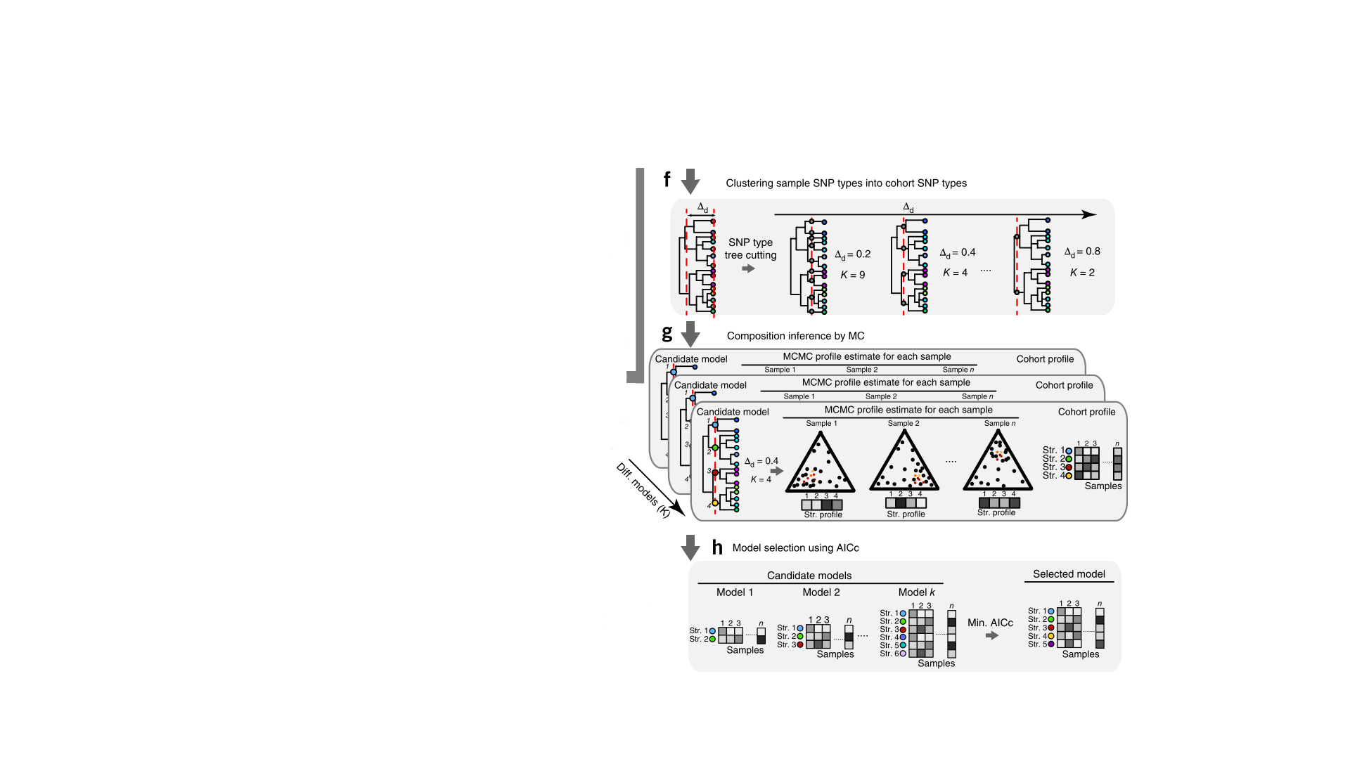
What do they actually do?

Slide 7
Learning objectives
Understand what FBA is and how it is different from kinetic modelling
Get hands on experience looking at FBA models
Understand how FBA models are constructed

Slide 8
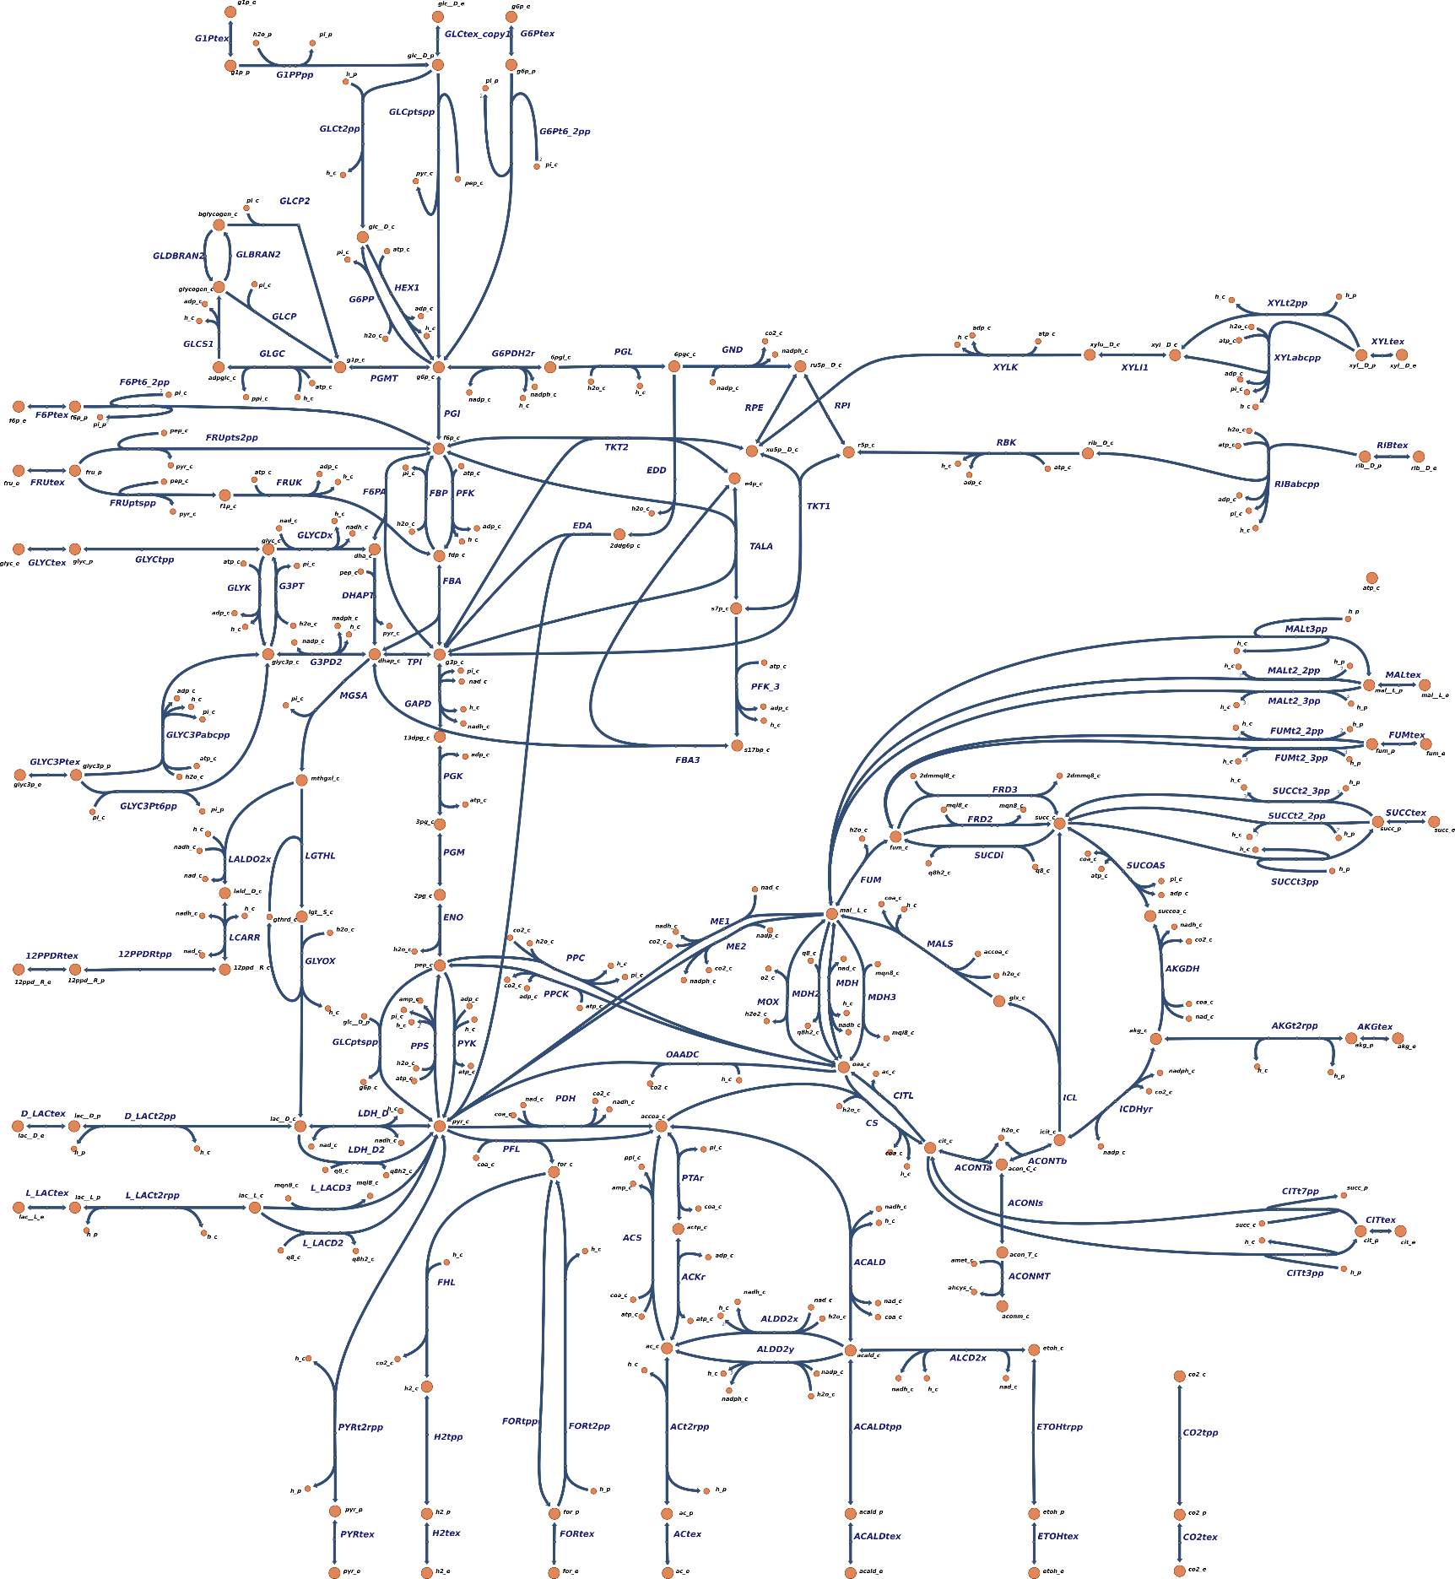
We know a lot about metabolism
Fructose
Glycolysis
Xylose
TCA cycle
Lactose
Fermentation end products

Slide 9
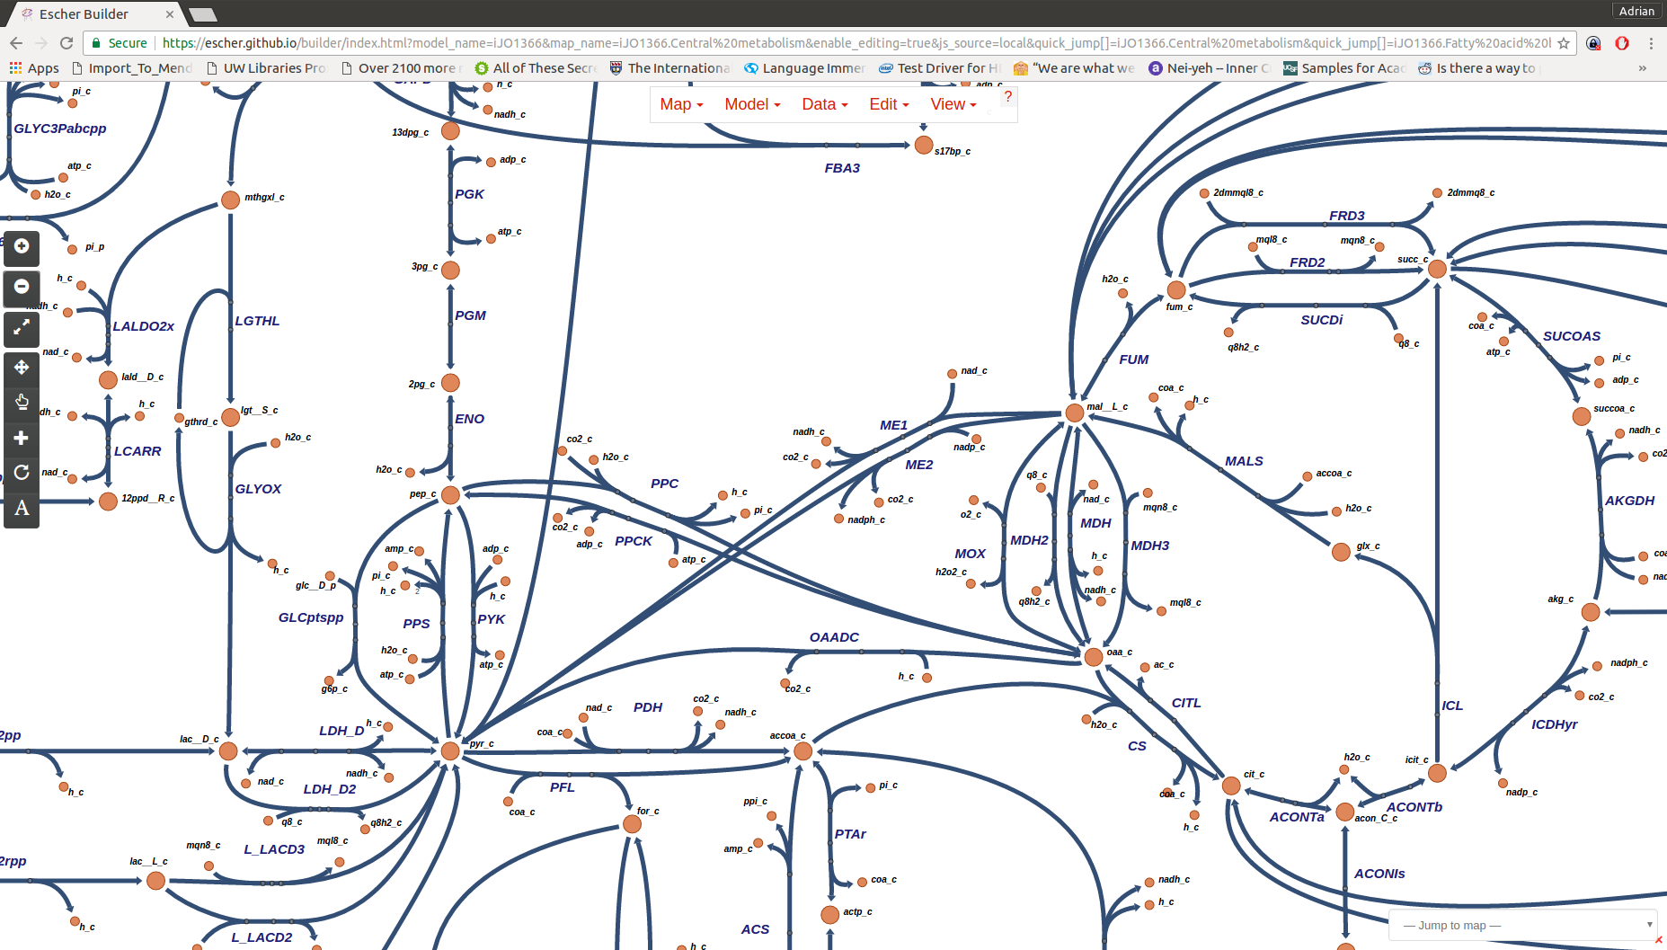
Escher - an interactive display tool

Slide 10
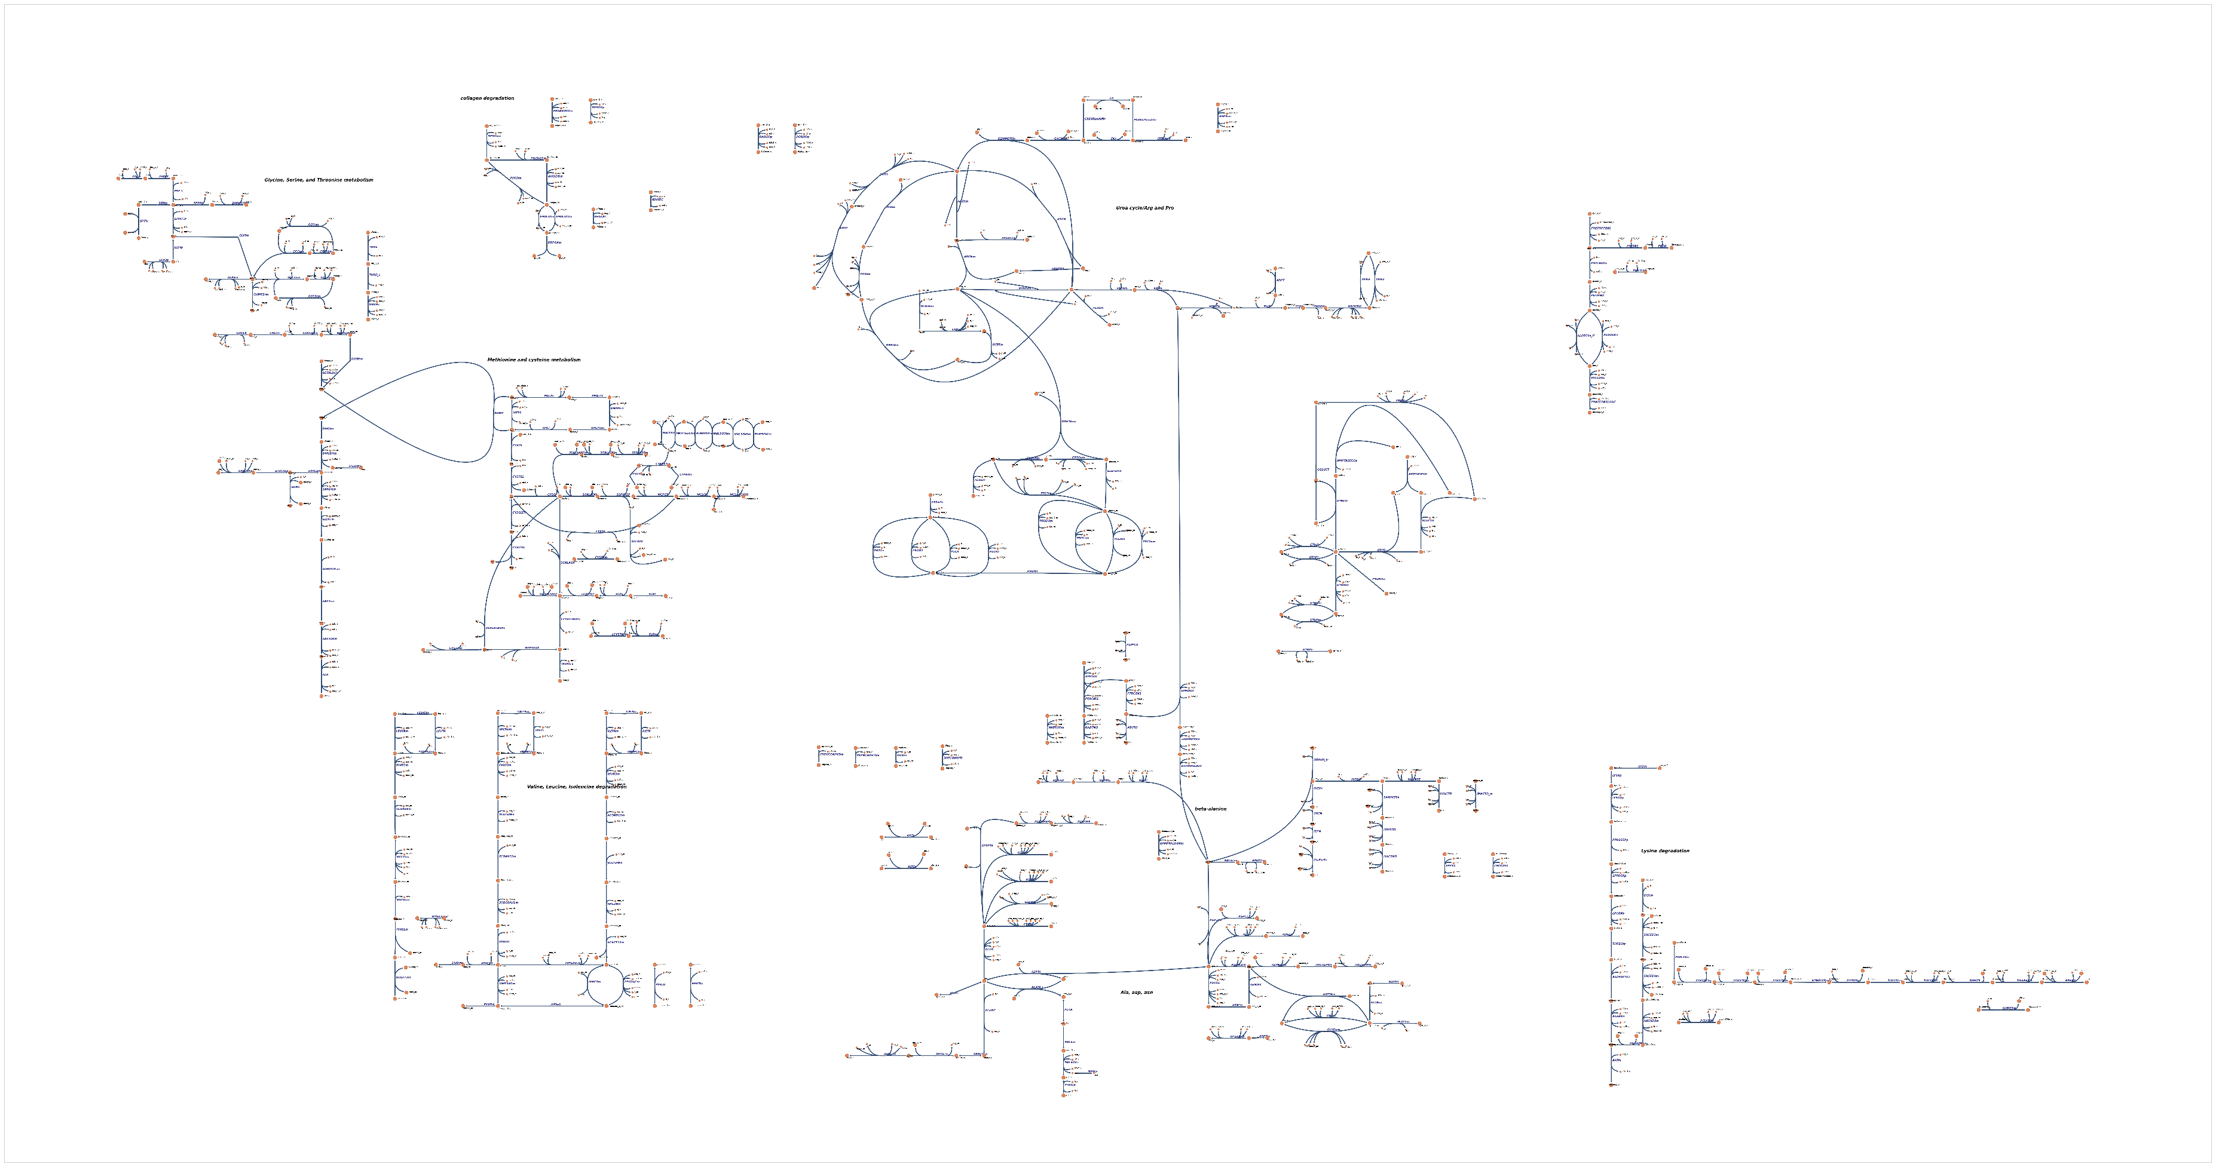
Amino acid metabolism
Arg and Pro
(Urea cycle)
Met and Cys

Slide 11
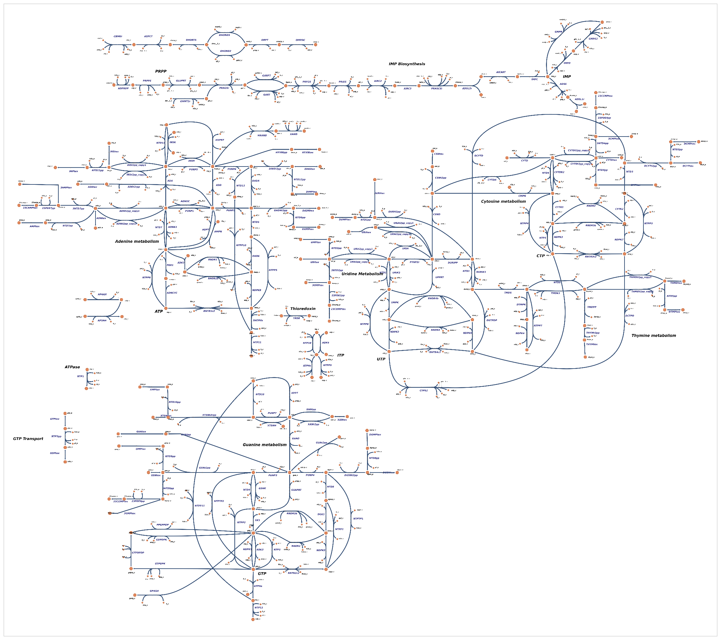
Nucleotide metabolism
Cytosine and Thymine
Guanine
Adenine

Slide 12
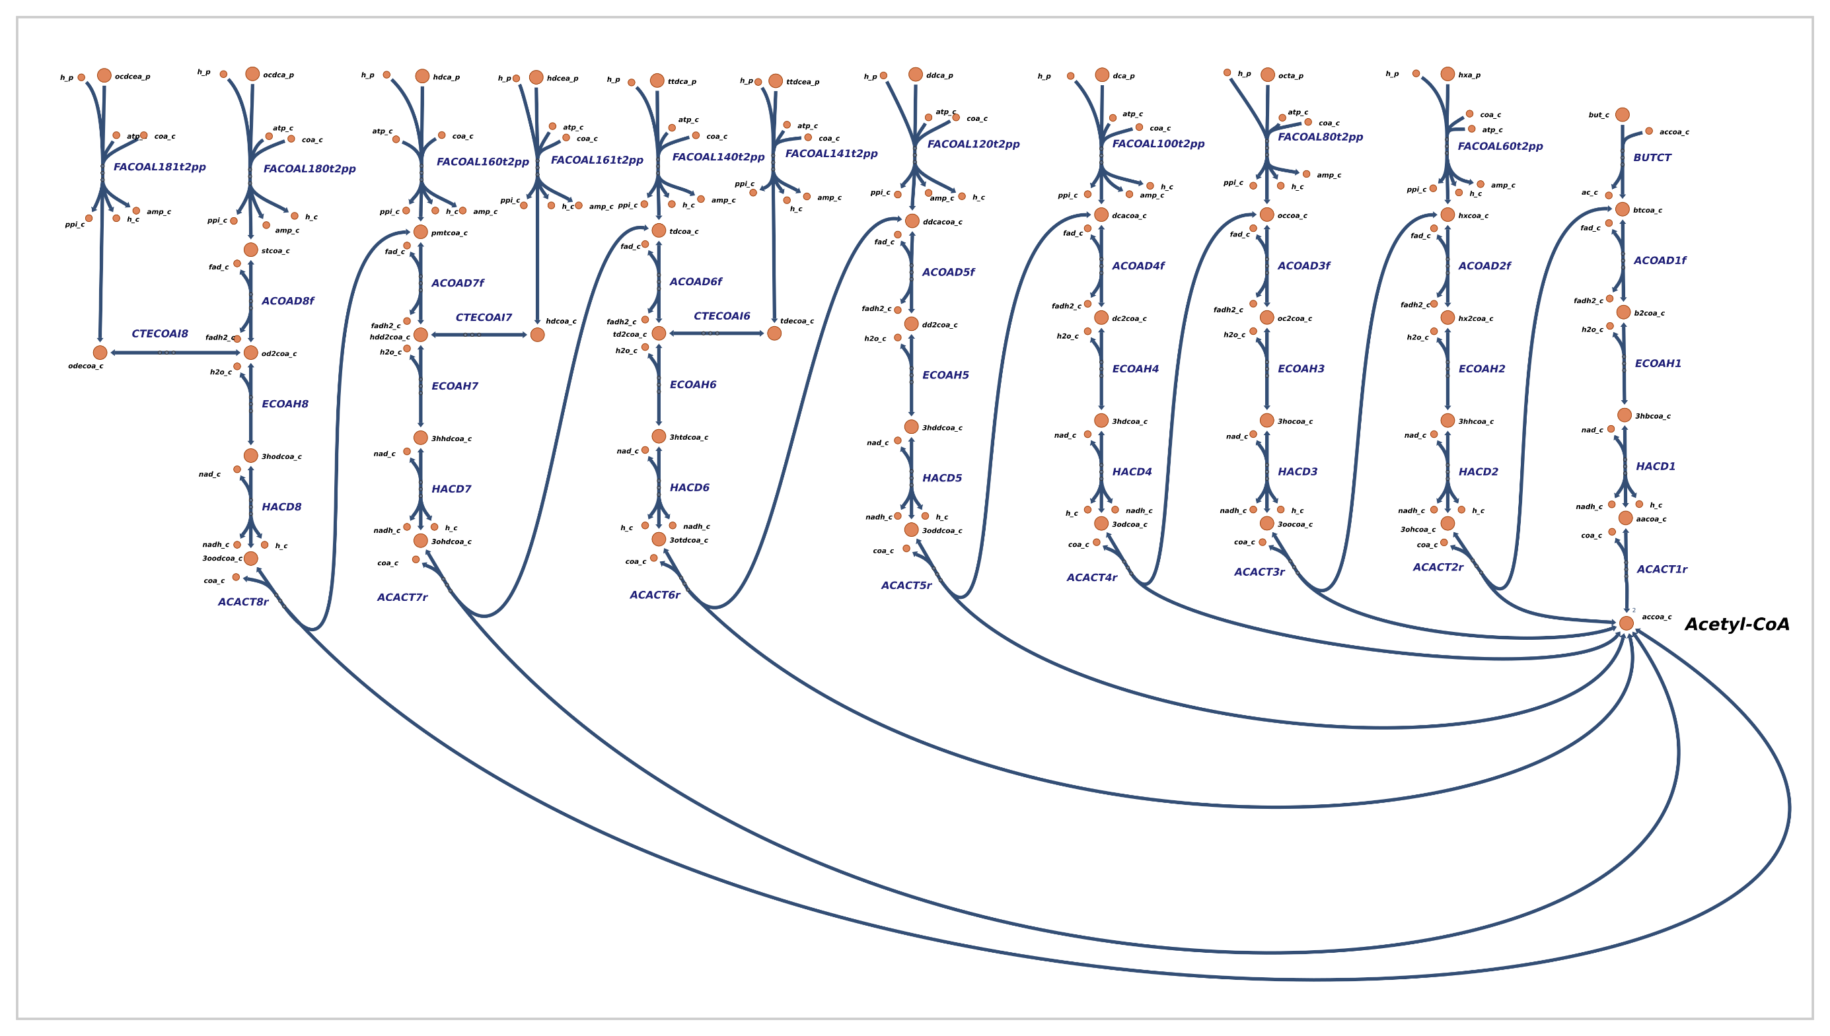
Fatty acid metabolism

Slide 13
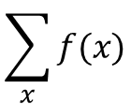
The goal of FBA is to model all this information
$$\sum_{x}{f(x)}$$
iAF1260
1668 Metabolites
2382 Reactions

Slide 14
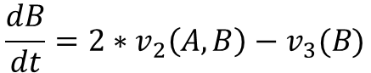
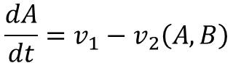
Kinetic modelling – what FBA is not
B
v₁
v₂(A,B)
v₃ (B)
A
B
Difficulties
Determining a value for the parameters
Determining the function for v₂, v₃
Nonlinear nature of that function
1000s of differential equations
$$\frac{dA}{dt}=v_{1}−v_{2}\left(A,B\right)$$
$$\frac{dB}{dt}={2∗v}_{2}\left(A,B\right)−v_{3}(B)$$

Slide 15
Simplifications of FBA
Ignore the concentrations of metabolites (A,B)
Assume that equilibrium has been reached
Try to find a single solution to the fluxes, ignoring the complexity of the function v₂(A,B)
Use the reaction stoichiometry as a constraint to maximize biomass production

Slide 16
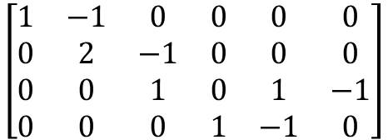
Toy FBA model
v₄
v₁
v₂
6 reactions
A
B
B
D
v₅
$$\left[\begin{matrix}1 & −1 & 0 & 0 & 0 & 0 \\ 0 & 2 & −1 & 0 & 0 & 0 \\ 0 & 0 & 1 & 0 & 1 & −1 \\ 0 & 0 & 0 & 1 & −1 & 0\end{matrix}\right]$$
v₃
4 metabolites
C
v₆

Slide 17
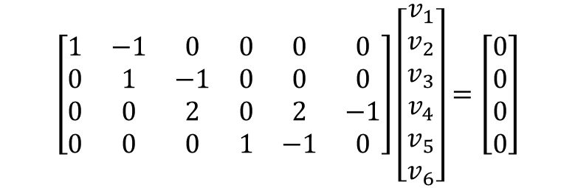
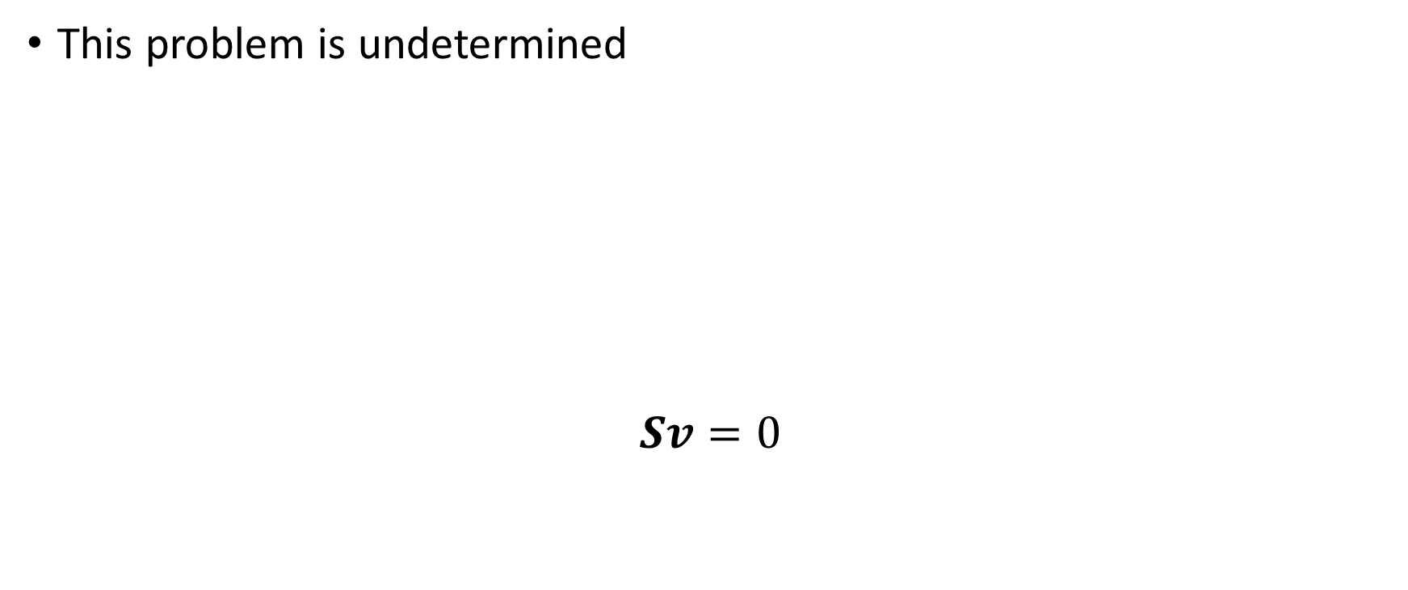
How can we solve for the fluxes?
This problem is undetermined
$$Sv=0$$
$$\left[\begin{matrix}1 & −1 & 0 & 0 & 0 & 0 \\ 0 & 1 & −1 & 0 & 0 & 0 \\ 0 & 0 & 2 & 0 & 2 & −1 \\ 0 & 0 & 0 & 1 & −1 & 0\end{matrix}\right]\left[\begin{matrix}v_{1} \\ v_{2} \\ v_{3} \\ v_{4} \\ v_{5} \\ v_{6}\end{matrix}\right]=\left[\begin{matrix}0 \\ 0 \\ 0 \\ 0\end{matrix}\right]$$

Slide 18
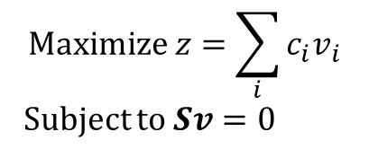
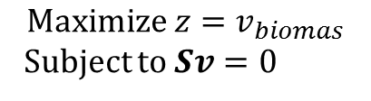
Define an objective function
Maximize the biomass reaction
v₄
v₁
v₂
A
B
B
D
v_{biomass}
C
E
v₅
v₃
$$Maximize z=v_{biomas}$$
Subject to $Sv=0$
C
$$Maximize z=\sum_{i}{c_{i}v_{i}}$$
Subject to $Sv=0$
v₆

Slide 19
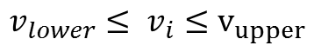
Define constrains on the fluxes
[D]
Not realistic to have unlimited flux
v₄
[A]
v₁
v₂
A
B
B
D
$${v_{lower}≤ v}_{i}≤v_{upper}$$
v₅
v₃
C
v₆

Slide 20
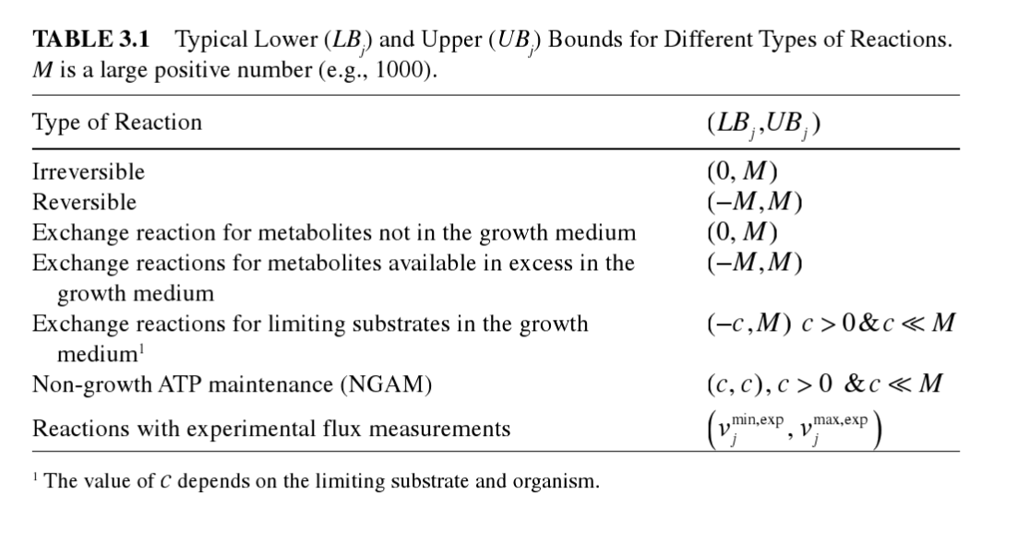
How do we decide on the constraints on fluxes?

Slide 21
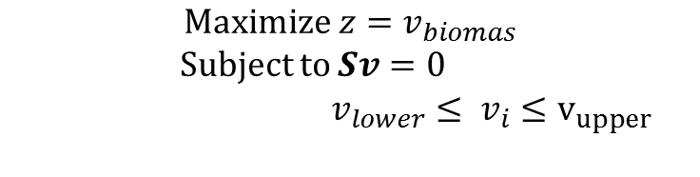
Full formulation
v₄
v_{biomass}
C
E
v₁
v₂
A
B
B
D
$$Maximize z=v_{biomas}$$
Subject to $Sv=0$
${v_{lower}≤ v}_{i}≤v_{upper}$
v₅
v₃
C
v₆

Slide 22
Applications
Predicting the effect of knockouts
Maximizing the production of metabolites
Test growth rate using different nutrients

Slide 23
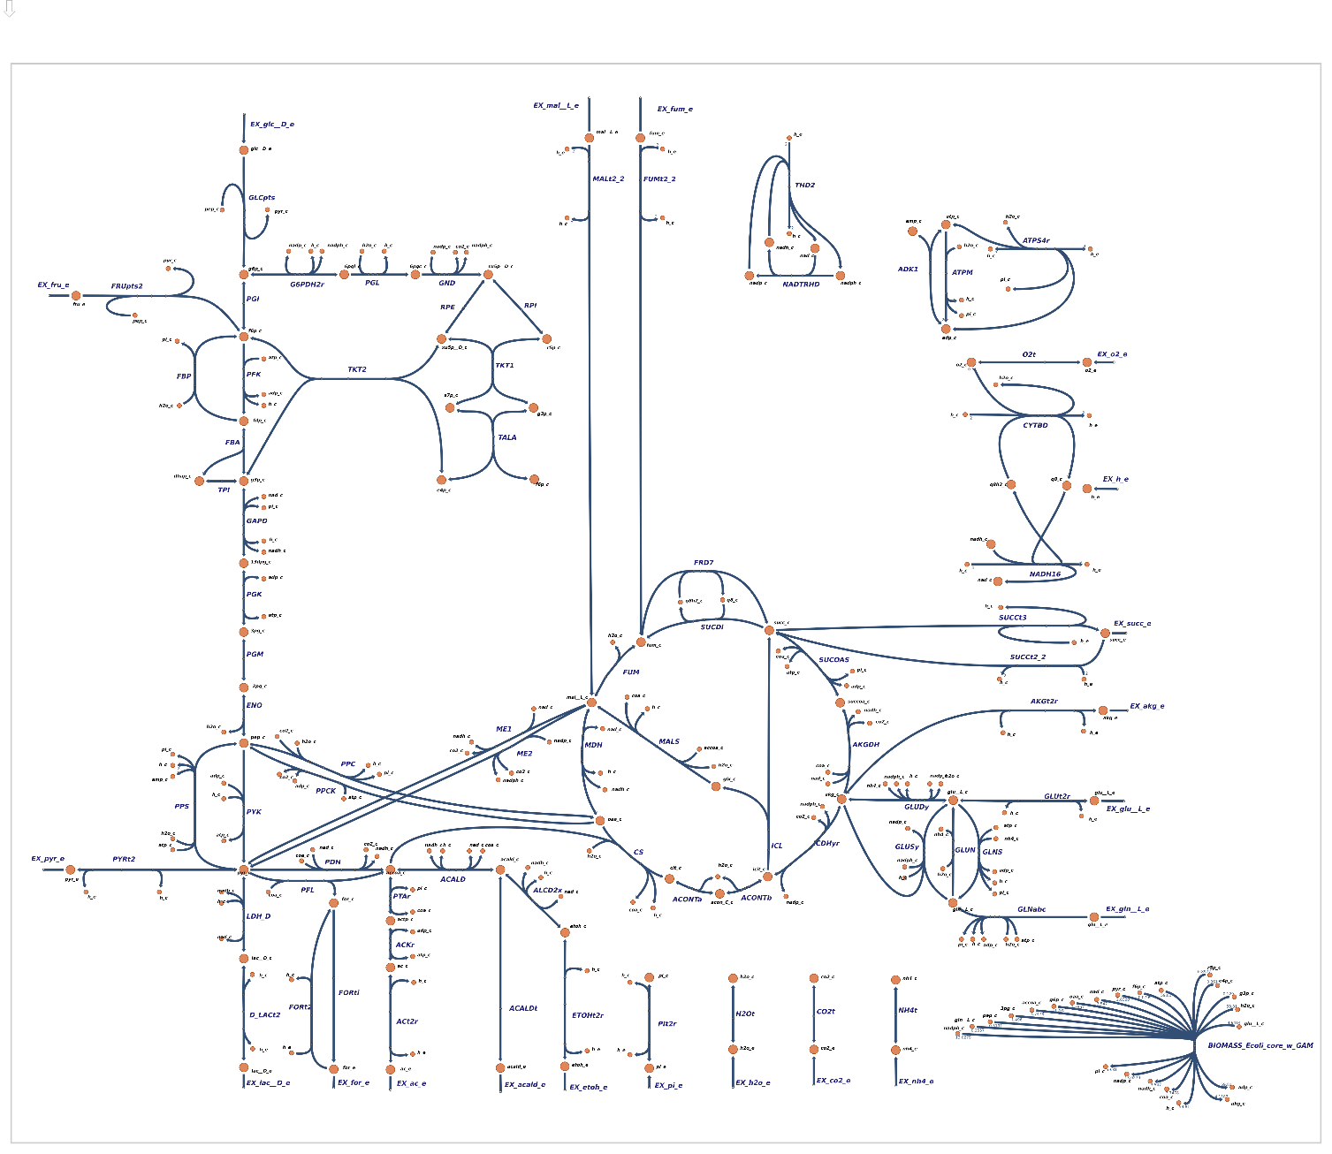
E. coli core model

Slide 24
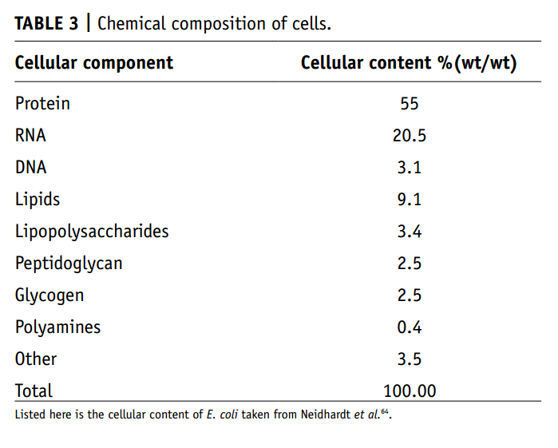
The biomass reaction is more complex than just ATP

Slide 25
E. coli core model biomass reaction
1.7867 oaa[c] + 0.361 e4p[c] + 0.2557 gln-L[c] + 0.129 g3p[c] + 0.5191 pep[c] + 0.8977 r5p[c] + 4.9414 glu-L[c] + 0.205 g6p[c] + 13.0279 nadph[c] + 2.8328 pyr[c] + 3.547 nad[c] + 0.0709 f6p[c] + 3.7478 accoa[c] + 59.81 h2o[c] + 59.81 atp[c] + 1.496 3pg[c] --> 59.81 h[c] + 4.1182 akg[c] + 59.81 adp[c] + 13.0279 nadp[c] + 3.547 nadh[c] + 59.81 pi[c] + 3.7478 coa[c]

Slide 26
Biomass reaction from a full E. coli model
0.04148 pe160_p + 54.462 h2o_c + 0.3432 lys__L_c + 0.1537 met__L_c + 0.000447 nadp_c + 0.007106 fe2_c + 0.1776 k_c + 0.004737 ca2_c + 0.000223 10fthf_c + 0.2905 ile__L_c + 0.000223 amet_c + 0.001831 nad_c + 0.003948 so4_c + 0.000223 thmpp_c + 0.011843 nh4_c + 0.003158 mobd_c + 0.000223 pheme_c + 0.004737 cl_c + 0.2632 glu__L_c + 0.6126 gly_c + 0.1335 ctp_c + 0.2632 gln__L_c + 0.4232 val__L_c + 0.01389 murein5px4p_p + 0.05684 trp__L_c + 0.003158 zn2_c + 0.2411 asp__L_c + 0.2537 thr__L_c + 0.09158 cys__L_c + 0.2211 pro__L_c + 0.2151 gtp_c + 0.04889 pe161_p + 0.1441 utp_c + 0.003158 cu2_c + 0.007106 fe3_c + 0.000223 pydx5p_c + 0.02617 datp_c + 0.02617 dttp_c + 0.02233 pe160_c + 0.003158 cobalt2_c + 0.000223 ribflv_c + 0.02632 pe161_c + 0.01945 kdo2lipid4_e + 0.000576 coa_c + 0.09474 his__L_c + 0.2958 arg__L_c + 0.1379 tyr__L_c + 0.000223 fad_c + 0.000223 2ohph_c + 0.1759 phe__L_c + 0.000223 sheme_c + 0.5137 ala__L_c + 0.2158 ser__L_c + 0.02702 dctp_c + 0.02702 dgtp_c + 0.003158 mn2_c + 0.4505 leu__L_c + 0.000223 thf_c + 59.984 atp_c + 0.007895 mg2_c + 0.2411 asn__L_c + 0.000223 mlthf_c + 5.5e-05 udcpdp_c --> 59.81 adp_c + 59.81 h_c + 59.806 pi_c + 0.7739 ppi_c

Slide 27
E. coli core demonstration

Slide 28
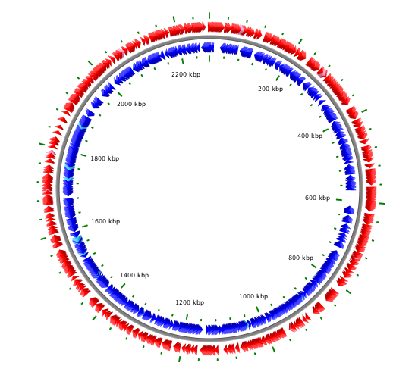
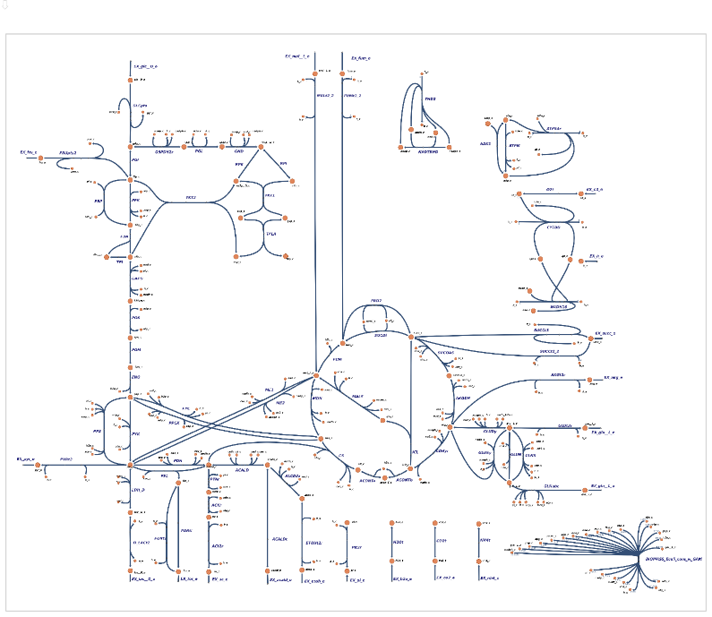

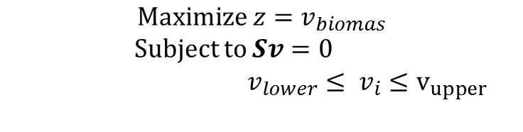
How are these models constructed?
BLAST
Known information about metabolism (KEGG)
Sequenced Genome
$$Maximize z=v_{biomas}$$
Subject to $Sv=0$
${v_{lower}≤ v}_{i}≤v_{upper}$

Slide 29
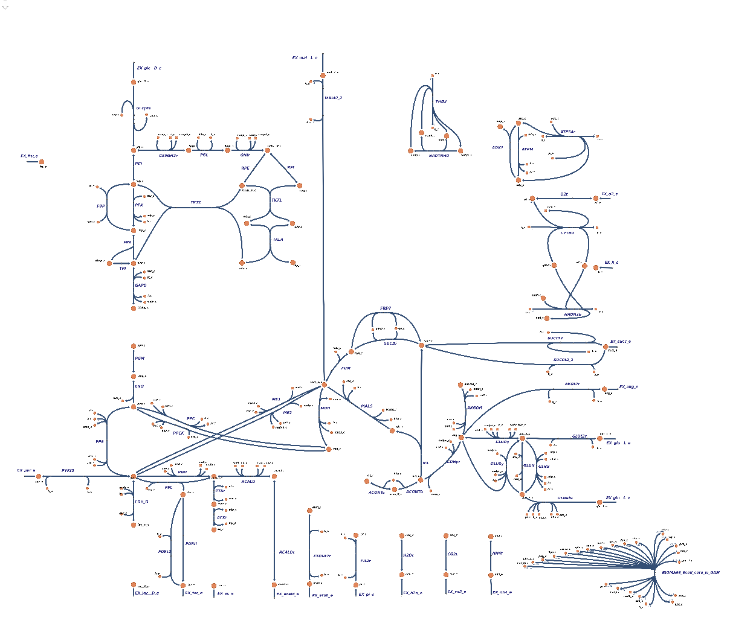
Draft models are going to be full of holes
Draft model
Curated model

Slide 30
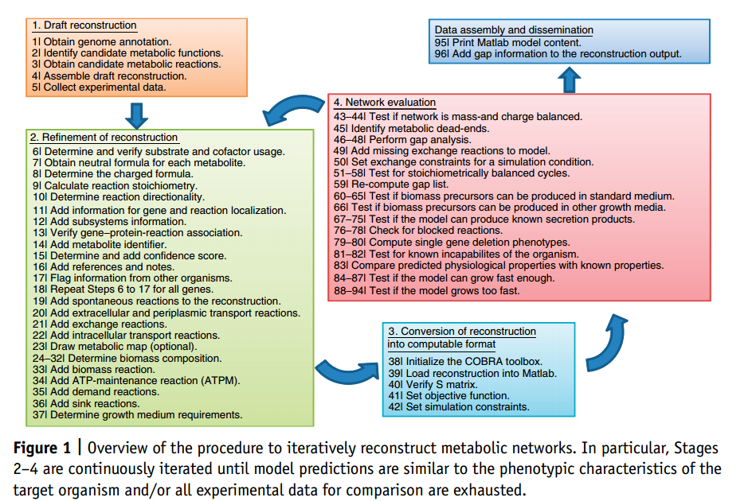
Detailed experimental manipulation required to create curated models

Slide 31
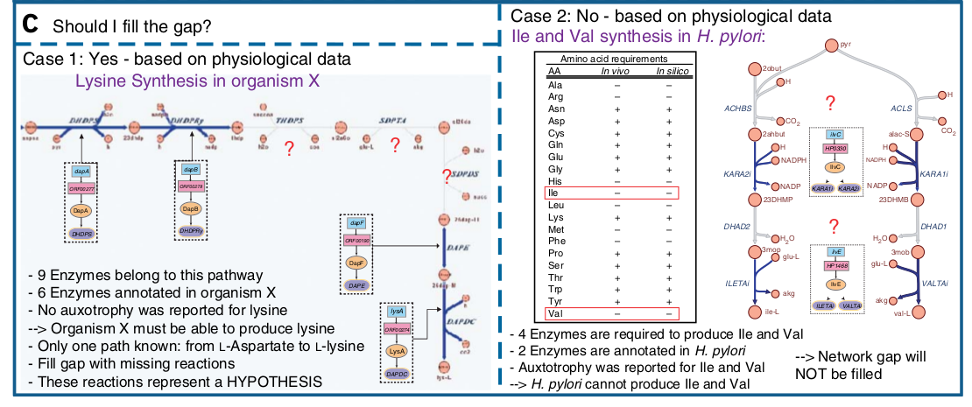
Detailed experimental manipulation required to create curated models

Slide 32
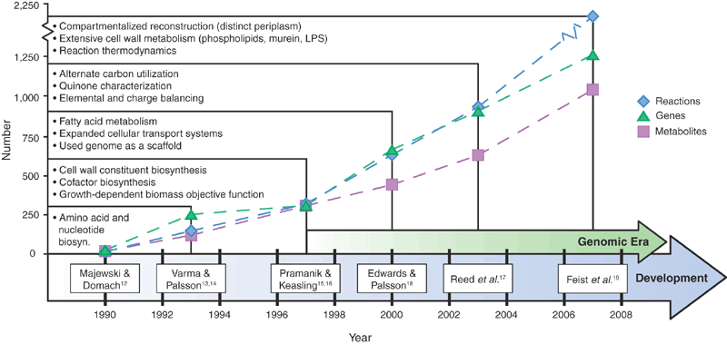
E. coli has the most detailed models
Feist and Palsson 2008

